Slide 1
© 2018 Cengage Learning. All Rights Reserved. May not be scanned, copied or duplicated, or posted to a publicly accessible website, in whole or in part.

Slide 2
Segmentation
3
© 2018 Cengage Learning.® May not be scanned, copied or duplicated, or posted to a publicly accessible website, in whole or in part.
3. 2

Slide 3
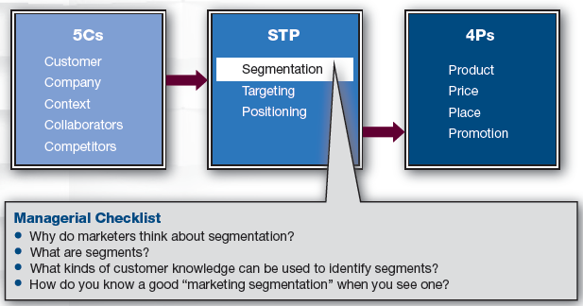
Marketing Framework
3

Slide 4
Discussion Question #1
Name a product in which everyone wants the same thing.
4

Slide 5
Segmentation (slide 1 of 3)
Psychologists
Consumers have different motivations that drive their purchases
Economists
Imperfect competition exists; consumers have unique needs
Marketers
The market is comprised of different segments
5

Slide 6
Segmentation (slide 2 of 3)
Segmentation
Breaking the market into more homogeneous consumer groups
A single product, price, or promotion is unlikely to satisfy all consumers’ needs
e.g., Taylor Swift appeals to tweens; Robert Redford appeals to seniors
6

Slide 7
Segments Defined
Market segment
A group of customers who share similar inclinations toward a brand
e.g., One segment might purchase a car primarily to get from A to B while another segment may purchase a car primarily to impress their friends
Marketers’ goal
Create marketing mixes that meet the segment’s needs
7

Slide 8
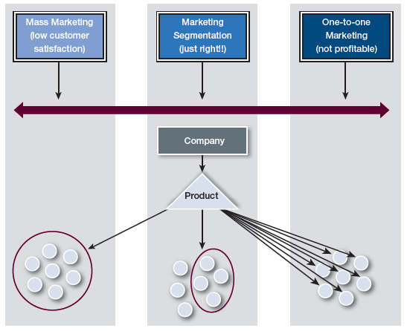
Marketing Segmentation
8

Slide 9
Types of Segmentation (slide 1 of 2)
Mass marketing
All customers are treated the same
Is usually more efficient but not effective in meeting customer needs
e.g., Pepsi seems to be mass marketed but is not
Pepsi, Diet Pepsi, caffeine-free Pepsi, 2-liters, 12-pack cans, 6-pack bottles, etc.
9

Slide 10
Types of Segmentation (slide 2 of 2)
One-to-one marketing
Each customer serves as a segment
Product is tailored for each person’s desires
Is usually more effective in meeting customers’ needs but hard to achieve efficiently and may involve quality issues
e.g., Dell allows customers to “build” their own computers; however, options are limited
10

Slide 11
Discussion Questions #2
List companies/products that are close to providing
One-to-one marketing and
Mass marketing.
What are the pros/cons of mass marketing?
What are the pros/cons of one-to-one marketing?
11

Slide 12
Segmentation (slide 3 of 3)
Segmentation falls between one-to-one and mass marketing
As segment size increases, segments become more heterogeneous
As segment size decreases, segments become less profitable
Marketers need the “optimal” segment size
Niche
Targeting small market that firm serves well
12

Slide 13
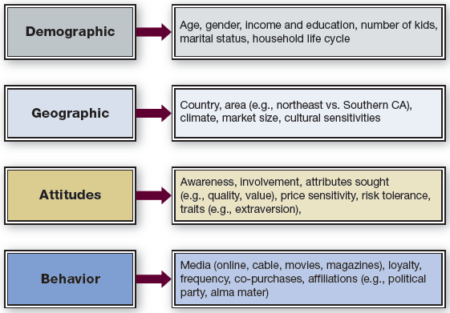
Bases for Segmenting in B2C
13

Slide 14
Segmentation: Demographics
Demographics
Gender, age, household composition, stage in life cycle, education, income, ethnicity
Demographic variables are clear and easy to recognize
However, they border on being simplistic stereotypes
14

Slide 15
Segmentation: Geographic
Geographic distinctions between customers can change preferences/needs
Cultural differences can exist between countries or within a country
e.g., Southern USA prefers spicier food
Urban living is different than small town
e.g., NYC residents want smaller dishwashers
Hot climates require different products than cold climates
e.g., Minnesotans need snow-blowers
15

Slide 16
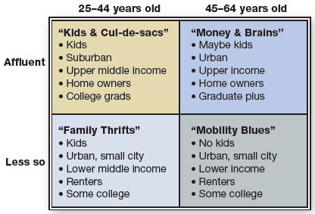
Segmentation: Geographic/Demographic
Combining geographic and demographic information can be powerful

Slide 17
Segmentation: Psychological
Psychological: get inside the heads and hearts of customers
Attitudes: e.g., Favorable attitude toward “green” products
Knowledge & awareness: e.g., Don’t know about the product
Wants and needs: e.g., Need for safety
Affiliations: e.g., Members of the AMA
Traits: e.g., Extroverts who want to socialize
Expertise & involvement: e.g., New motorcycle enthusiasts
Brand attributes sought: e.g., Low price and red color
Risk orientation: e.g., Risk-adverse late technology adopters
Aspirations: e.g., Want to be a better cook
Vary in terms of relevancy to the product
17

Slide 18
Segmentation: Psychological/Lifestyle
Psychological & lifestyle
e.g., Gardeners, food connoisseurs
VALS: psychographic segmentation tool
Marketers determine people’s attitudes and what they value and use this knowledge to communicate effectively
e.g., Strivers are trendy, like to impress, often impulsive
18

Slide 19
Segmentation: Behavioral (slide 1 of 2)
Behavioral: behaviors people engage in
Attitudes can’t be observed; behaviors can
Intentions do not always equal behaviors
Behaviors help predict future behavior
Current users; Nonusers
Nonusers may use competitors or don’t buy
80:20: 80% of sales come from 20% of customers
It costs 6 times more to acquire a new customer compared to retaining a loyal one
19

Slide 20
Segmentation: Behavioral (slide 2 of 2)
Patterns of co-purchasing
Purchase a new house, usually purchase new appliances, curtains, etc.
Create opportunities for cross-selling
20

Slide 21
Discussion Questions #3
What bases should you use when segmenting a market?
A music lesson business?
A mayoral candidate?
A grocery store?
21

Slide 22
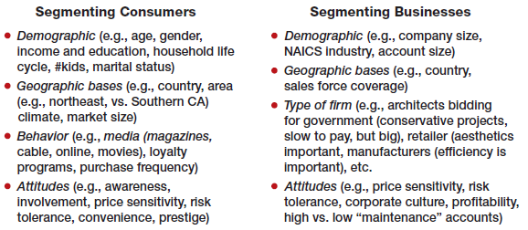
B2B Compared to B2C Segmentation
Primary distinction between B2B & B2C is that the data sources are different

Slide 23
Concept in Action
Insurance industry example
Industry is large and competitive
Segment market using cluster analysis
Survey customers; identify questions where there is variability in responses
If no variability in responses, do not segment on that variable
Useful segmentation has variation across groups
23

Slide 24
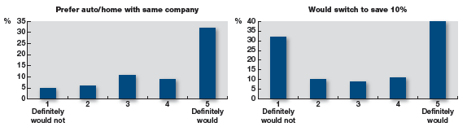
Concept in Action: Discussion Question
Which variables would you segment on?

Slide 25
How to Segment the Market (slide 1 of 2)
Iterate between two approaches
Managerial: top-down ideation
Customer-based: bottom-up customer needs assessment
Doing both approaches is important
Managers may hold beliefs that are not consistent with systematically gathered data
25

Slide 26
How to Segment the Market (slide 2 of 2)
Begin with understanding the marketplace and then gather information on the customer’s perspective
A segment may look desirable in terms of size and growth but be saturated with competitors and not consistent with firm goals
26

Slide 27
How to Evaluate Segmentation Schemes (slide 1 of 3)
Does the segmentation scheme have
Data to identify segments?
Census data: available but may not be useful
VALS & Prizm: expensive
Specific survey may not be available
Databases to access segments?
Databases that give access to the specific people within your chosen segments
27

Slide 28
How to Evaluate Segmentation Schemes (slide 2 of 3)
Does the segmentation scheme have
Profitability?
Size matters but so does frequency & depth ($) of purchase, price sensitivity, segment stability, growth potential, competitive intensity, etc.
Use information to estimate segment value
Be careful not to segment too narrowly
Determine what matters to your product
28

Slide 29
How to Evaluate Segmentation Schemes (slide 3 of 3)
Does the segmentation scheme
Fit with corporate goals?
Consider your firm’s goals and image
e.g., Subzero (high-end refrigeration) does not “fit” with the low-end refrigerator market
Actionable?
Marketers must focus on the right criteria
It is common to link usage, attitudinal, etc., variables to demographic variables to make the segment more actionable
29

Slide 30
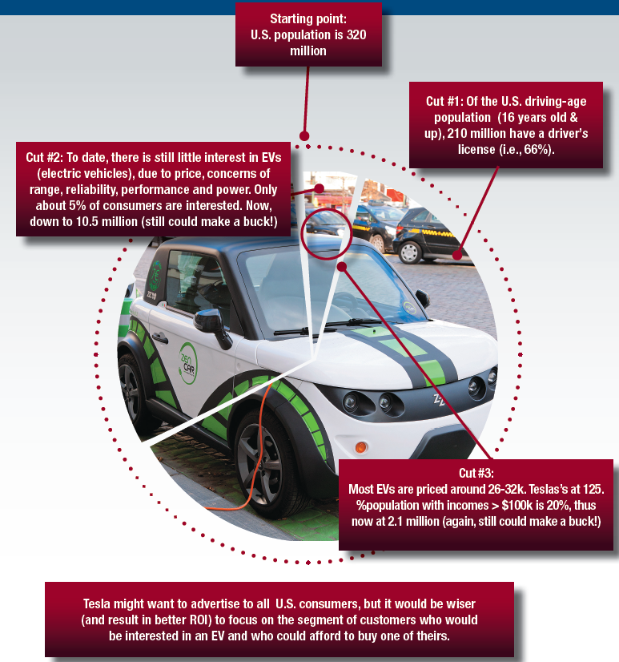
Anatomy of a Market Segment
30

Slide 31
Discussion Questions #4
Develop a segmentation scheme for a new pizza shop located two blocks from campus.
Does your scheme meet all of the criteria for a good segmentation scheme?
31

Slide 32
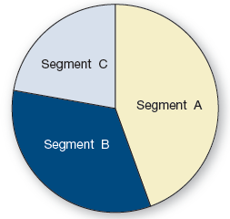
Segmentation Strategies (slide 1 of 4)
Segments in the Marketplace

Slide 33
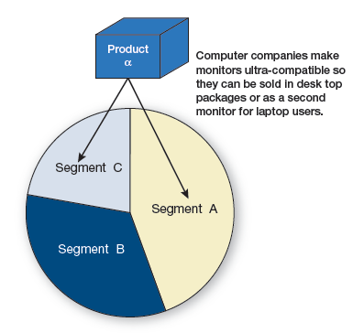
Segmentation Strategies (slide 2 of 4)
Breadth Strategy: Reaching Multiple Segments

Slide 34
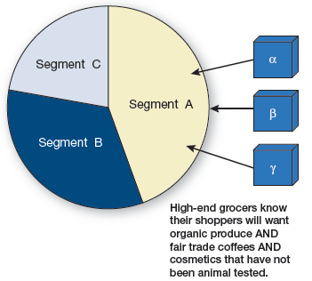
Segmentation Strategies (slide 3 of 4)
Depth Strategy: Serving One Segment Well

Slide 35
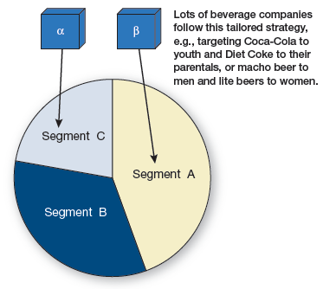
Segmentation Strategies (slide 4 of 4)
Tailored Strategy: Customizing for Segments

Slide 36
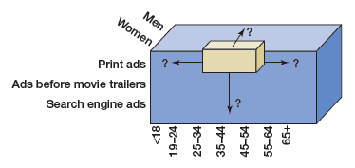
Discussion Question #5
You are currently selling pizza to college students. Discuss at least two methods to expand your pizza shop business.

Slide 37
Managerial Recap (slide 1 of 4)
Segments should be
Profitable
Identifiable
Accessible
Actionable
Compatible with company goals
37

Slide 38
Managerial Recap (slide 2 of 4)
Marketers create segments because customers vary in preferences
It is usually impossible to please all customers with one product
Market segments are groups of customers with similar reactions to the company’s brand
38

Slide 39
Managerial Recap (slide 3 of 4)
Segments can be formed on nearly any kind of differentiating information
Segments are best created by iterating between the managerial understanding of the marketplace and good data that may be processed (e.g., via cluster analysis) to identify similarities in purchasing propensities
39

Slide 40
Managerial Recap (slide 4 of 4)
Segmentation schemes should be
Based on data
Sustained by a database to help access the customers
Profitable enough to serve
Sensible with respect to the larger corporate goals and planning
Actionable
40

